Slide 1
PCD
Manish Ranjan Behera

Slide 2
Overview
Pro:Centric Direct (PCD) is a Hospitality TV solution.
LG released a new version of their reliable hotel TV management platform, Pro:Centric Direct 3.0. This iteration builds on the successful features of the past while introducing revolutionary new features to propel hotel management into the future.
The system has long been used by hoteliers to simplify communications with their guests. The platform is based around the hotel TV, using remote management to offer guests customised information and the ability to communicate with the front desk through their hotel TVs. Pro:Centric Direct 3.0 takes all of this to the next level.

Slide 3
Features like
Internet of Things
As guests become accustomed to using the IoT devices in their own homes, many hotels find themselves scrambling to catch up. LG Pro:Centric Direct 3.0 simplifies the process by allowing guests to control their lights, curtains and even their locks through their hotel TV. Pro:Centric Direct 3.0 uses the popular Zigbee protocol to integrate IoT devices into the TV system. This means hotel managers can remotely configure and deploy IoT settings by room or room block. No other hotel management system is offering an in-house IoT solution. With Pro:Centric Direct 3.0, hoteliers don’t have to wrestle with integrating third-party solutions. The TV, management platform and IoT integration are all part of one easily installed solution.
Voice command
Many guests settle in at home with commands to Siri, Alexa or Cortana. Pro:Centric Direct 3.0 allows hotelier to offer their guests the same convenience. It comes with an embedded voice command system that allows guests to control the TV and IoT devices with their words. No more will guests have to find the remote to turn off the TV as they drift to sleep. When they wake up, they can tell the TV to show them the day’s weather or nearby attractions and it will comply. Best of all, it is locally loaded, meaning everything happens in the TV without access to the cloud. Data is secure and the system is compliant with European privacy laws.

Slide 4
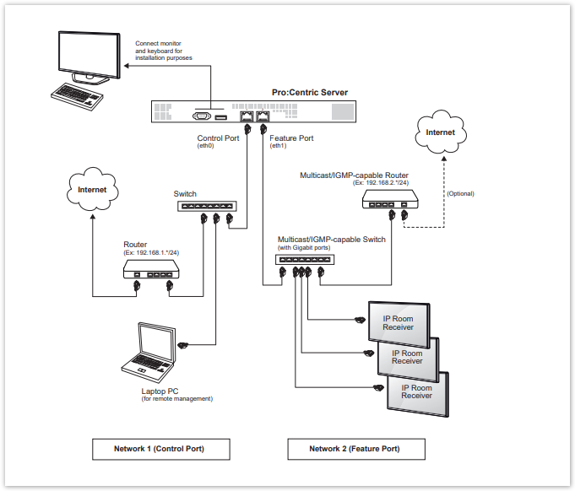

Slide 5
